Slide 1
Face Recognition Algorithm Based on VGG Network Model and SVM
Đào Việt Duy – MSSV:
Nguyễn Duy Hàn Lâm – MSHV: 196005004

Slide 2
Citation
Dataset:
R Vemulapalli, A Agarwala, “A Compact Embedding for Facial Expression Similarity”, CoRR, abs/1811.11283, 2018.

Slide 3

CNN

Slide 4
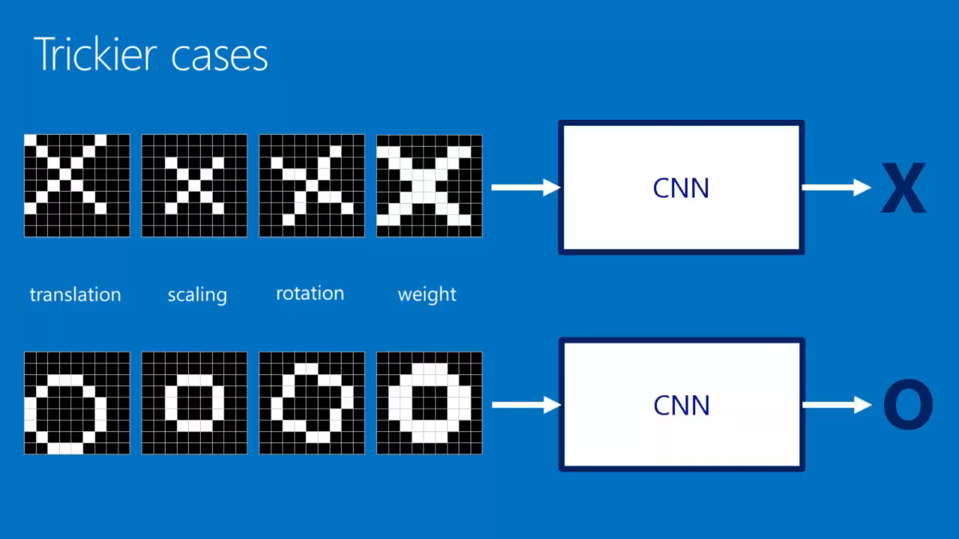

Slide 5
Convolution layer

Slide 6
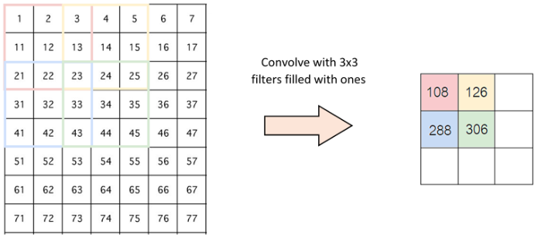
Stride - padding

Slide 7
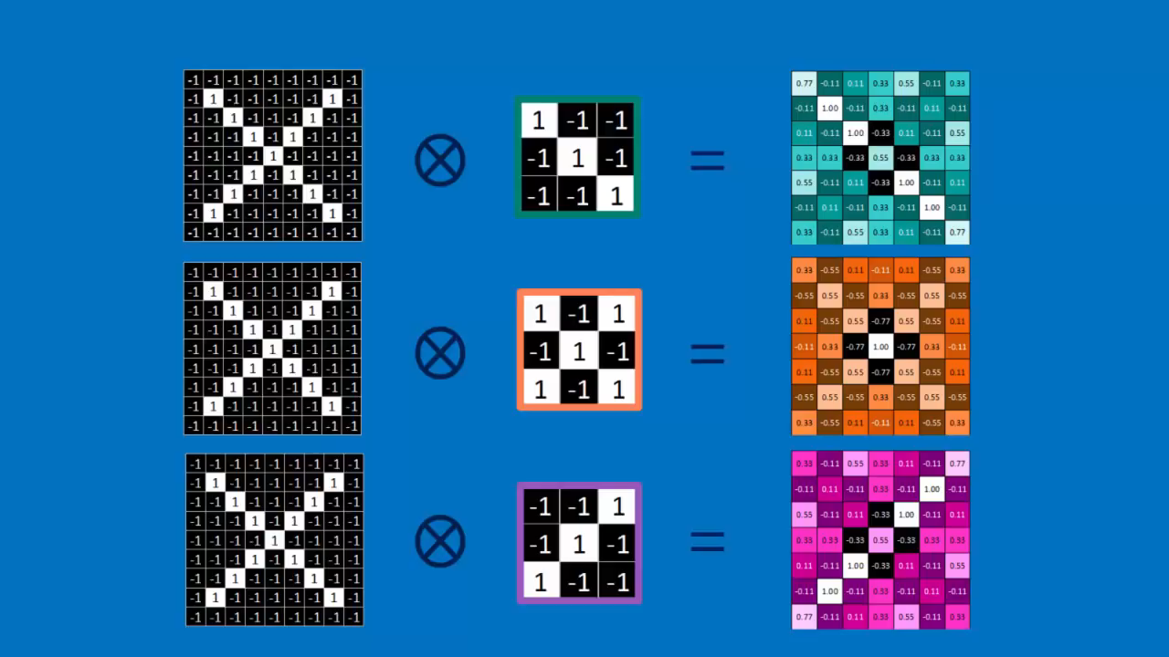

Slide 8
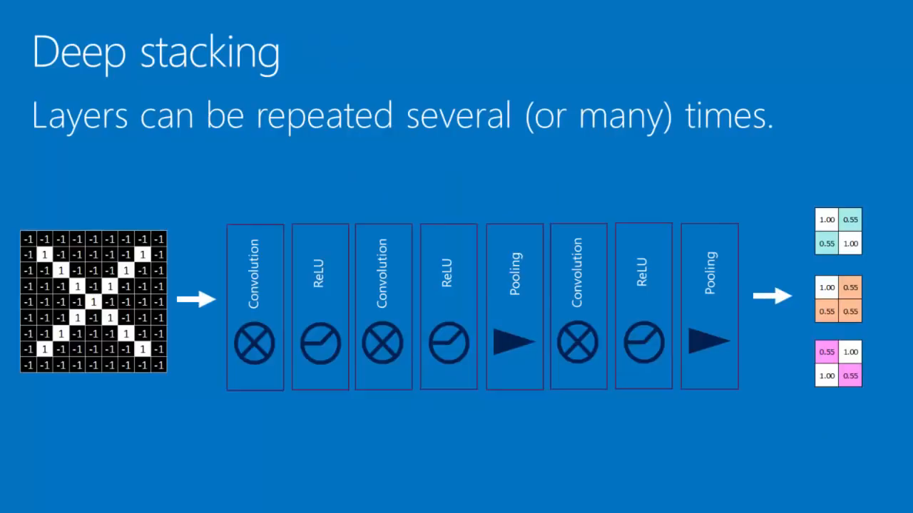

Slide 9
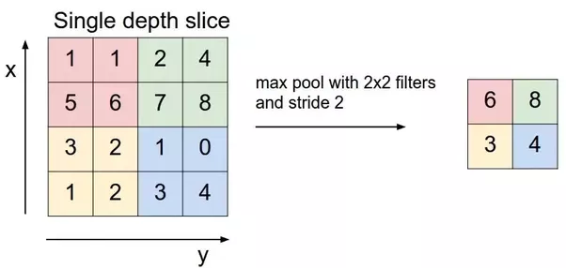
Pooling layer

Slide 10
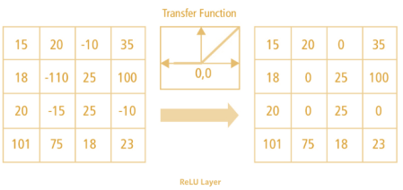
Softmax function( Normalization)

Slide 11
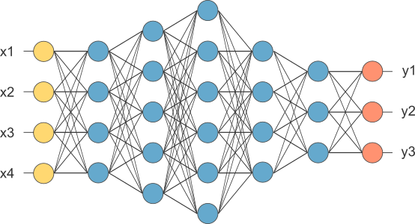
Fully connected layer

Slide 12
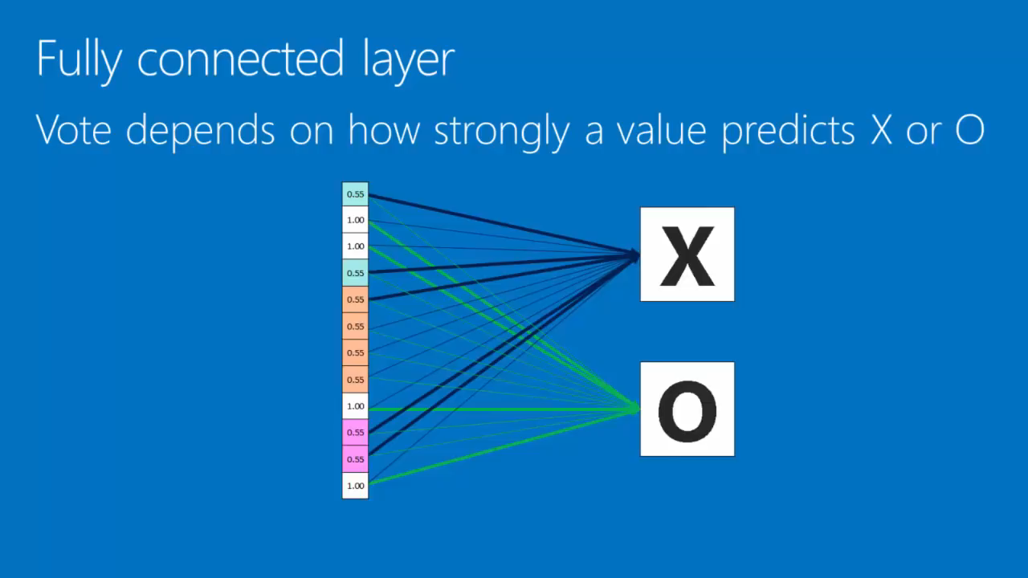

Slide 13
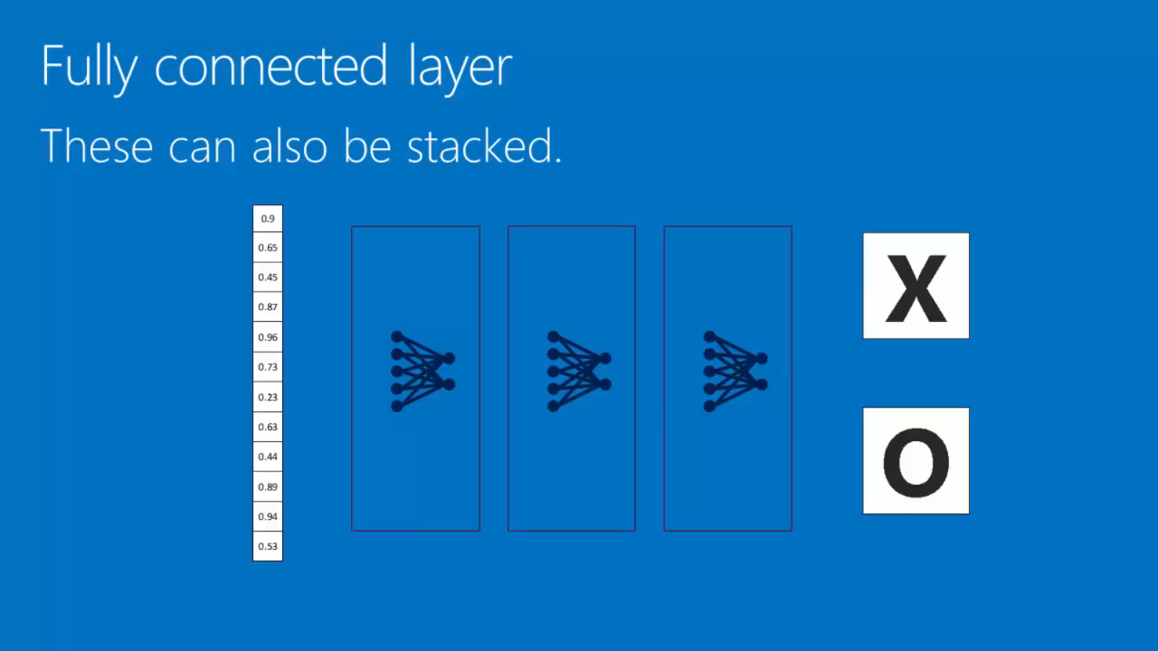

Slide 14
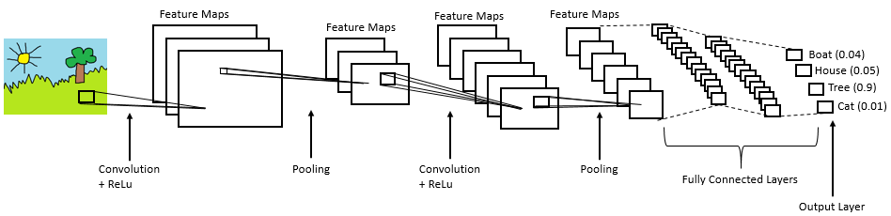

Slide 15
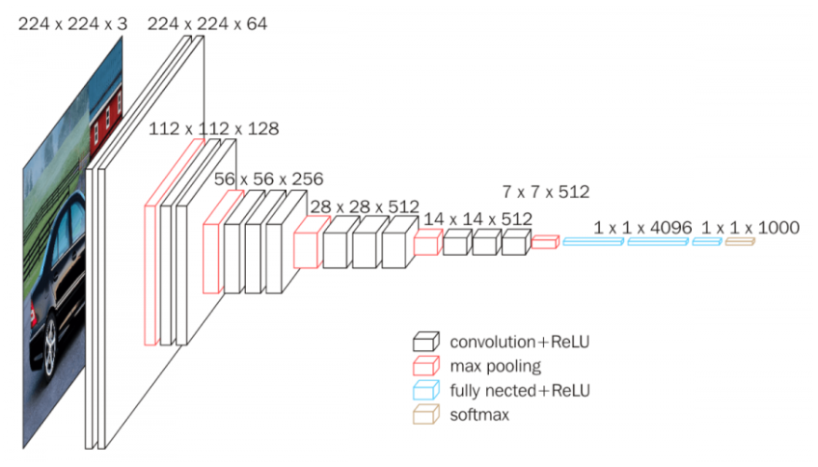
VGG16 model concept

